Slide 1
Māori Quiz Documentation
Thomas Wilson

Slide 2
Māori Quiz
Link to GitHub Repository: https://github.com/twschool/Assessment
Links to Trello board / project management tools: Māori quiz | Trello
Link to final version of your program:
Ensure you have made these links ‘public’ so that they are open to anyone, including the marker. The link to your program is the final outcome of this whole project – your finished program.

Slide 3
Describe relevant Implications 1:
Additional rows can be added by clicking in the last cell and then using the Tab key
Relevant implication | Describe the implication and give an example
Functionality | Functionality is about guaranteeing that the program works as expected. It should work for expected, boundary, and unexpected cases or inputs. For example, if my program asks the user to answer a multiple-choice question is should work for the expected inputs like “A” “B” “C” or “D” and should tell the user to “Type a valid answer” if an answer is not any of the above and is a unexpected input it should not crash if the user enters something invalid like “0” or “q”. My program needs to tell the user that the input is invalid and either pass or repeat the input question.
Usability | Usability is about how easily the end user can get the program to do what it is supposed to do. It deals with issues like making instructions or error messages clear and easy for users to read and understand. It is important to minimize or eliminate any frustration that the end user might encounter using your program.
Notes:
Additional rows can be added by clicking in the last cell and then using the Tab key

Slide 4
Describe relevant Implications 2:
Additional rows can be added by clicking in the last cell and then using the Tab key
Relevant implication | Describe the implication and give an example
Future proofing | Future proofing is about making a program which is flexible, adaptive and easy to modify later if necessary. The code needs to be well set out and commented so that another programmer can make changes easily at some future time. It is important not to have a massive string of code and rather an organized structure. This will be helpful for someone who wants to modify my code in the future because they need to be able to understand the purpose and reasoning behind different parts of the code. Also, its important to use constant variables rather than hard coded ones to minimize the number of places where changes need to be made as to keep the code simple and easy to modify at a future date.
Notes:
Additional rows can be added by clicking in the last cell and then using the Tab key

Slide 5
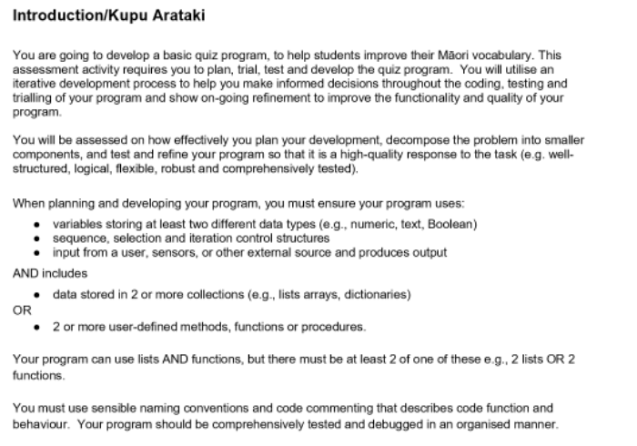
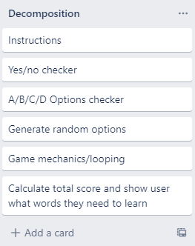
Decomposition:
Paste screenshots of your initial Trello board / task decomposition on this slide. If you have a long list, you might need to break it up into several slides.
Notes:
Paste screenshots of your initial Trello board / task decomposition on this slide. If you have a long list, you might need to break it up into several slides.

Slide 6
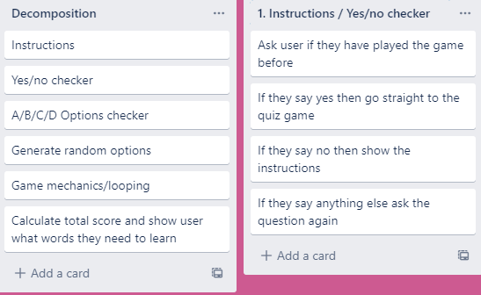
Component 1 –Instructions & Yes/No checker

Slide 7
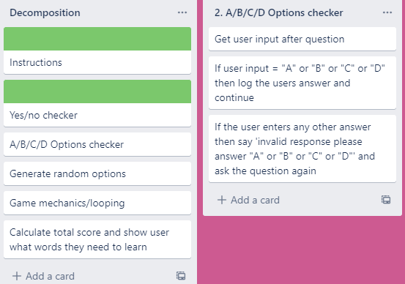
Component 2 – A/B/C/D Options checker

Slide 8
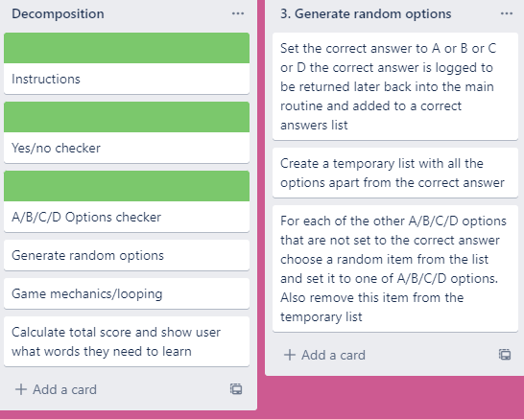
Component 3 – Generate random options

Slide 9
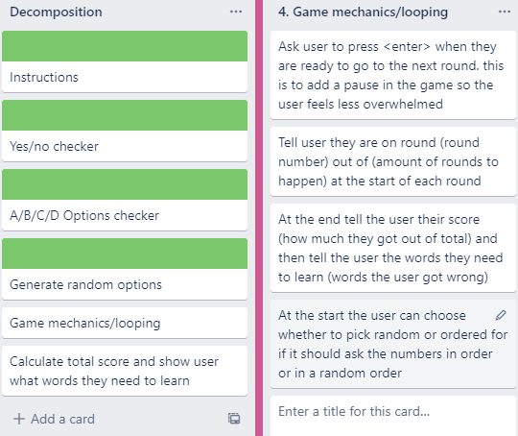
Component 4 – Game mechanics & Looping
Notes:
Additional rows can be added by clicking in the last cell and then using the Tab key

Slide 10
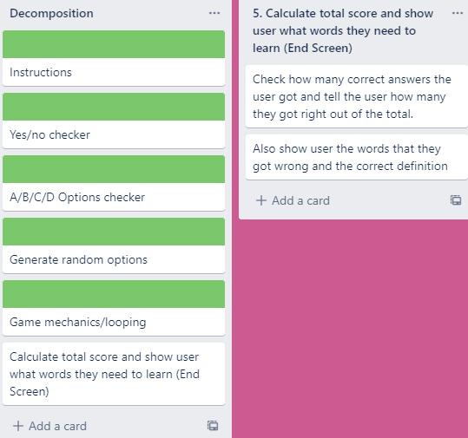
Component 5 - Statement formatter

Slide 11
Yes/No checker- Test Plan
Additional rows can be added by clicking in the last cell and then using the Tab key
Test Cases - input | Expected output
Yes | Program continues
Y | Program continues
yes | Program continues
No | Program continues
N | Program continues
Maybe | Please enter either “Yes” or “No”
Notes:
Additional rows can be added by clicking in the last cell and then using the Tab key

Slide 12
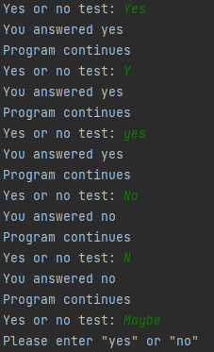
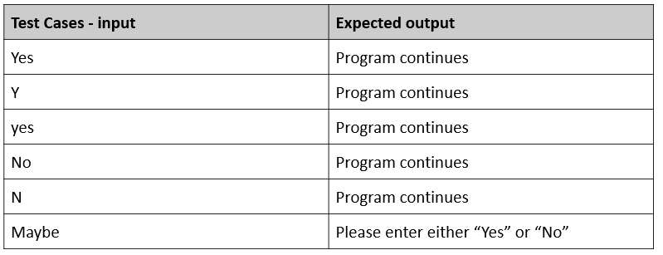
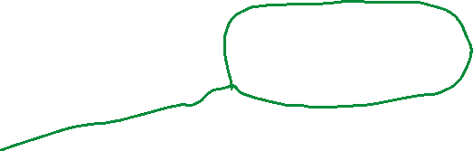
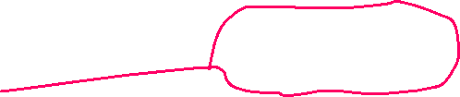
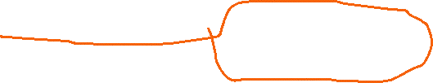
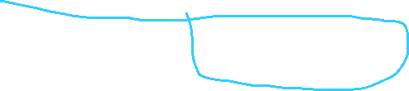
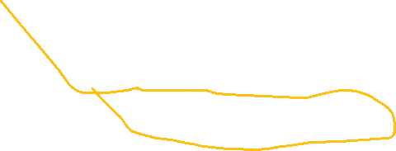
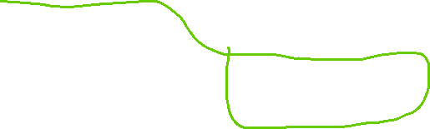
Yes/no checker test results
All test cases worked as expected

Slide 13
Yes/No checker - Trialling
Trial 1 generate_random_options_v1.py | Trialed having the input inside the main routine to minimize the code in the main routine. This version of the code returned with no information e.g.; return instead of return “Text”.
Trial 2 yes_no_v3.py | I realized the input needed to be in the main routine and not the function, so the input statement was moved to outside the function. This resulted in function having to return 2 values inside a list. This changed the yes_no function to be multipurpose for different input questions.
Notes:
NOTE: Trialling needs to happen for at least 2 of your components but is not necessary for ALL components.
Trialling is not the same as testing. Trialling is about finding different ways of building the same component. Show evidence of your trialling here. Select one of your trials for further development and give reasons for your choice.

Slide 14
Instructions - Test Plan
Additional rows can be added by clicking in the last cell and then using the Tab key
Test Cases - input | Expected output
Have you played before? Maybe | Please enter either “Yes” or “No”
Have you played before? Yes | Game starts
Have you played before? No | Show instructions, then start the game
Notes:
Additional rows can be added by clicking in the last cell and then using the Tab key

Slide 15

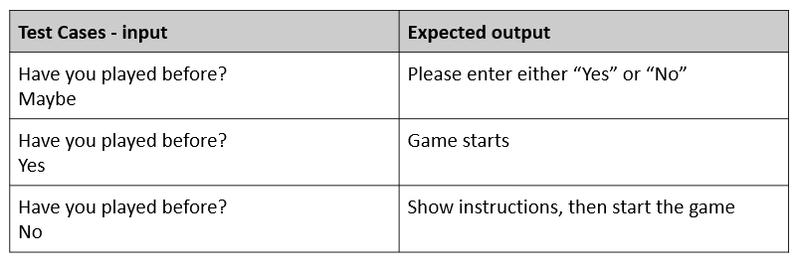
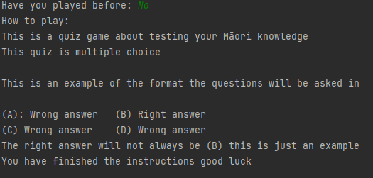


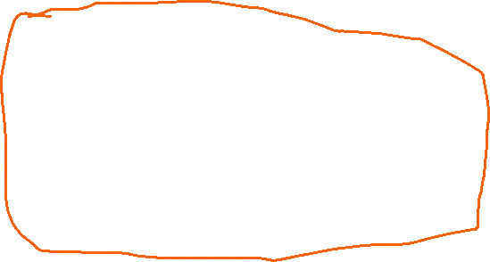
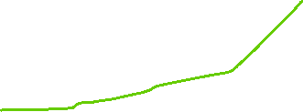
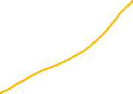



Instructions – Test results
All test cases worked as expected
Notes:
You must show the results of testing. For each component, include a screenshot proving it works. You can also include notes about each test.

Slide 16
How much - Test Plan
Test Cases - input | Expected output
xxii (invalid-string) | <error> Please enter a whole number between 1 and 10
0.5 (invalid-float) | <error> Please enter a whole number between 1 and 10
0 (invalid – too low) | <error> Please enter a whole number between 1 and 10
11 (invalid – too high) | <error> Please enter a whole number between 1 and 10
1 (valid – lower boundary) | Program continues
10 (valid – upper boundary) | Program continues
Notes:
Additional rows can be added by clicking in the last cell and then using the Tab key

Slide 17
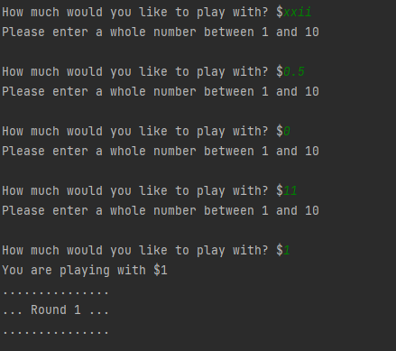
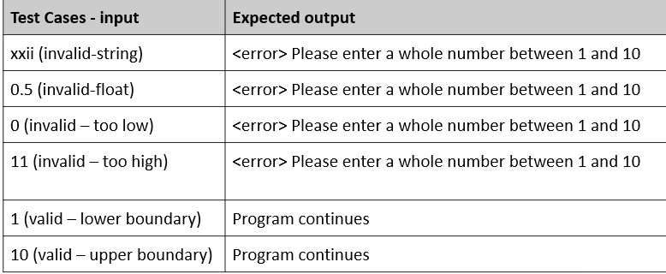
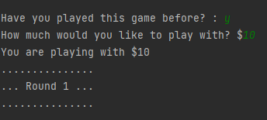
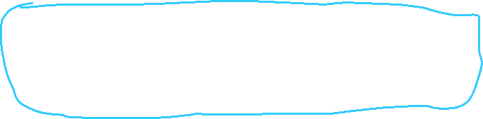
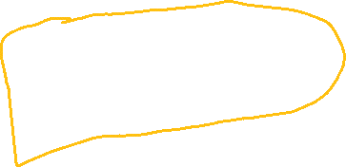



How much - Test Results
Notes:
Additional rows can be added by clicking in the last cell and then using the Tab key

Slide 18
Number checker (how much)- Trialling
Trial 1 04_how_much_v1.py | Trialed having the input inside the main routine and having most of the variables in the function including the question written out in full each time it was used this version didn’t return any input but I didn’t see this at the time.
Trial 2 04_how_much_v2.py | I moved most of the variables inside the function code so the variables were defined in the main routine but given a name in the function. This version was following the teachers example and returned the amount of money they had as a variable in the main routine.
Notes:
NOTE: Trialling needs to happen for at least 2 of your components but is not necessary for ALL components.
Trialling is not the same as testing. Trialling is about finding different ways of building the same component. Show evidence of your trialling here. Select one of your trials for further development and give reasons for your choice.

Slide 19
Test Plan – Tokens randomly generated
Additional rows can be added by clicking in the last cell and then using the Tab key
Test Cases - input | Expected output
Runs the program | Program should output 20 inputs with at least one of each of: horse, donkey, zebra and unicorn. The order of the tokens must be random.
Notes:
Additional rows can be added by clicking in the last cell and then using the Tab key

Slide 20
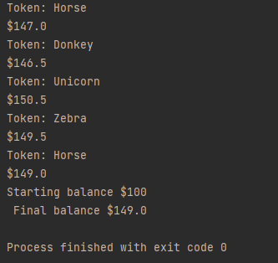
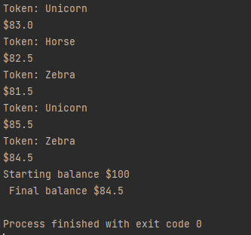
Generate random token - Testing
Testing on right (Trial 1) shows results for 100 rounds. 25% chance for a unicorn. 25% chance for a Zebra, Horse, or Donkey. The house was losing so I changed the percentages.
Testing on right (Trial 2) shows results for 100 rounds. 10% chance for a unicorn. 30% chance for a Zebra, Horse, or Donkey.
Notes:
Additional rows can be added by clicking in the last cell and then using the Tab key

Slide 21
Generate random token - Trialling
Trial 1 05_token_generator_v2 | The program chooses from a list of ‘Horse’, ‘Unicorn’, ‘Donkey’, or ‘Zebra’. When run 100 times it becomes clear that the house would lose money instead of making it.
Trial 2 05_token_generator_v2 | The program chooses from a list of 10 items. 10% chance to be unicorn 30% chance to either be a ‘Zebra’, ‘Horse’, or ‘Donkey’. When run for 100 rounds it becomes clear that the house has the advantage.
Notes:
Additional rows can be added by clicking in the last cell and then using the Tab key

Slide 22
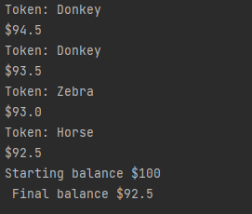
Tokens randomly generated- Test Results
Works as expected
Notes:
Additional rows can be added by clicking in the last cell and then using the Tab key

Slide 23
Test Plan – House has the advantage
Additional rows can be added by clicking in the last cell and then using the Tab key
Test Cases - input | Expected output
User starts with 100$ Run program | User should lose money (final balance should be less than 100$)
Notes:
Additional rows can be added by clicking in the last cell and then using the Tab key

Slide 24
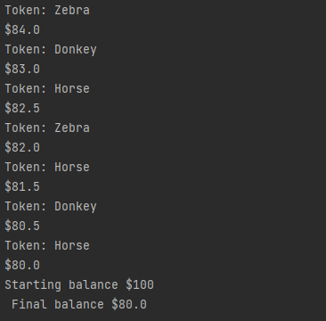
Tokens randomly generated- Test Results
Ran program 100 times
With a starting balance of 100$
Notes:
Additional rows can be added by clicking in the last cell and then using the Tab key

Slide 25
Game mechanics and looping- Test Plan
For testing purposes, each round the user will lose $1 (i.e.: They get a donkey each time)
Test Cases - input | Expected output
User starts with $5 User continues playing until the money runs out | Game should go for 5 rounds. Each round should be correctly numbered After 5 rounds, it should display ‘Sorry you have run out of money’
Starting amount 5$ User plays 3 rounds and then exits | Game should go for 3 rounds When user enters ‘X’ the game should end Final balance should be $2
Notes:
Additional rows can be added by clicking in the last cell and then using the Tab key

Slide 26
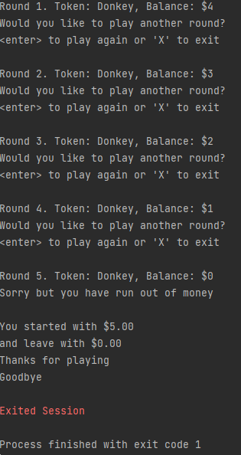
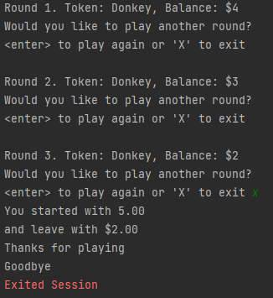
Game mechanics and looping- Testing
For testing purposes, each round the user will lose $1 (i.e.: They get a donkey each time)
User can exit when prompted
Summary includes starting and finishing balances
Ran out of money and ends the game as expected
Farewell message printed on exit
Notes:
Additional rows can be added by clicking in the last cell and then using the Tab key

Slide 27
Statement formatter - Test Plan
Test Cases - input | Expected output
Statement 1: “Welcome to the Lucky Unicorn game” Decoration: “*” | -------------------------------------------------------- --- Welcome to the Lucky Unicorn Game --- --------------------------------------------------------
Statement 2: “Congratulations, you got a Unicorn” | !!!!!!!!!!!!!!!!!!!!!!!!!!!!!!!!!!!!!!!!!!!!!!!!!! !!! Congratulations, you got a Unicorn !!! !!!!!!!!!!!!!!!!!!!!!!!!!!!!!!!!!!!!!!!!!!!!!!!!!!
Statement 3: | ************** *** Goodbye *** **************
Notes:
Additional rows can be added by clicking in the last cell and then using the Tab key

Slide 28
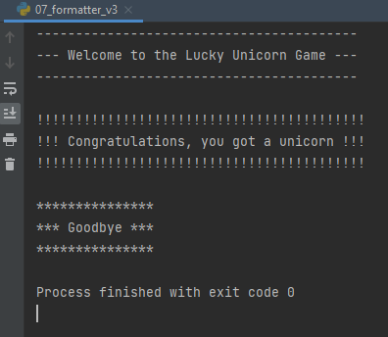
Statement formatter - Testing
Statement formatted function worked as expected and produced the expected results
Notes:
Additional rows can be added by clicking in the last cell and then using the Tab key

Slide 29
Assembled Outcome 1 – Test plan
Test Cases - input | Expected output
Run program Played before = Maybe Played before = No | Welcome message displays Invalid answer please answer “Yes” or “No” Instructions display
Enter amount to play with: xlii 0.5 0 11 1 | Error Error Error Error You are playing with $1
Notes:
Show testing for your assembled outcome below. This should include a test plan followed by screenshot proof.

Slide 30
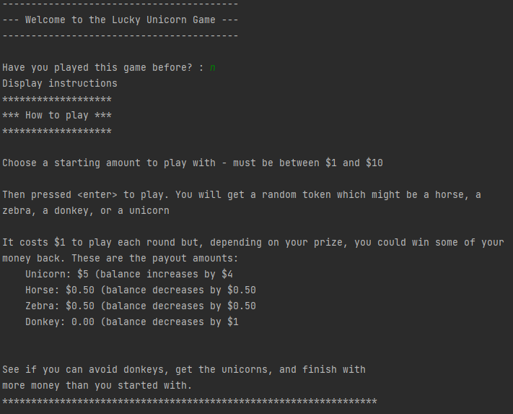
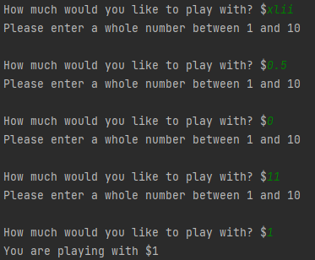
Assembled Outcome – Testing 1
Worked as expected – results produced
Match those in the plan on the preceding page
Notes:
Show testing for your assembled outcome below. This should include a test plan followed by screenshot proof.

Slide 31
Assembled Outcome 2 – Test plan
Test Cases - input | Expected output
Play with $1 until money runs out | For each round Random token generated Balance and round number updated At end: Stats generated showing starting amount of 1$ and final balance of $0.50 or $0.00
Run program Played before = Yes Amount to play with = 10 | Welcome message displays No instructions displayed
Notes:
Show testing for your assembled outcome below. This should include a test plan followed by screenshot proof.

Slide 32
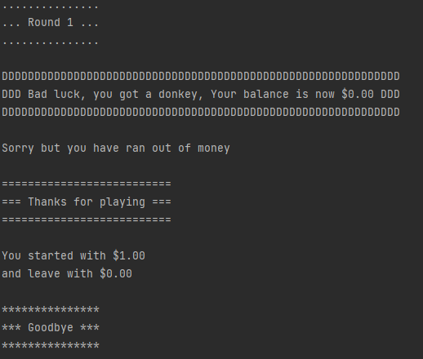
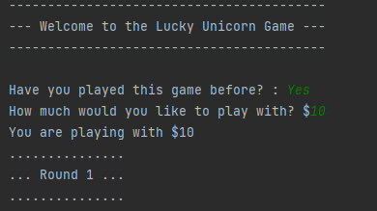
Assembled Outcome – Testing 2
Worked as expected – results produced
Match those in the plan on the preceding page
Notes:
Show testing for your assembled outcome below. This should include a test plan followed by screenshot proof.

Slide 33
Assembled Outcome 3 – Test plan
Test Cases - input | Expected output
Play until balance is $3.00/$2.50, then ‘X’ to quit | For each round: Random token generated Balance and round number updated (lose $1 for donkeys, lose $0.50 for a horse or zebra, and gain $4 for any unicorn At end: Stats generated showing starting amount of 10$ and final balance of $2.50 or $3.00
Notes:
Show testing for your assembled outcome below. This should include a test plan followed by screenshot proof.

Slide 34
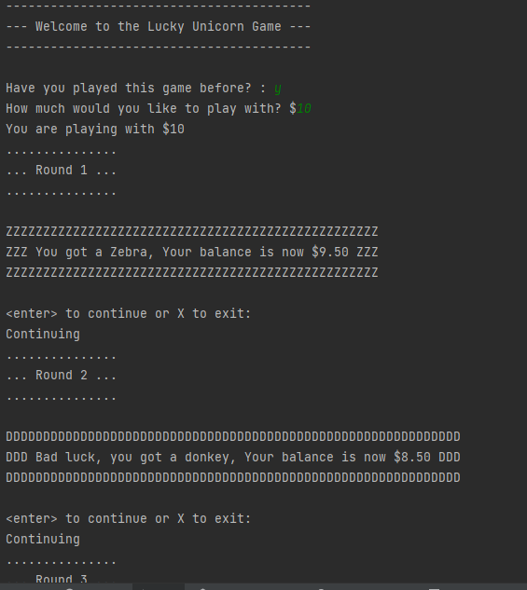
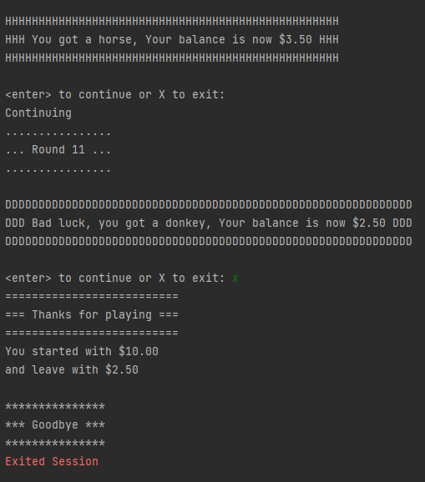
Assembled Outcome – Testing 3
Worked as expected – results produced
Match those in the plan on the preceding page
Notes:
Show testing for your assembled outcome below. This should include a test plan followed by screenshot proof.

Slide 35
Address relevant Implications:
Relevant implication | Explain how your final outcome addresses each implication
Functionality | I have excessively tested my outcome to make sure that the functionality implication has been addressed (i.e. it works for expected, unexpected, and boundary values).
Usability | The inclusion of optional instructions and clear error messages helps to make the outcome easy to use.
Aesthetics | I have carefully spaced the program’s output and used a statement generator to enhance its appearance. Whilst aesthetics is not the main focus of text based programs, ensuring the outcome looks good also helps address the usability implication.
Social | My program has a $10 limit on the amount users can spend. This addresses the social implications of gambling by making it difficult for users to spend an excessive amount of money.
Future-proofing | I avoided the use of literals and use functions throughout my code to make it more flexible and easier to modify in the future if necessary. The code is well set out and commented so that another programmer can change the program easier at any future time.

Slide 36
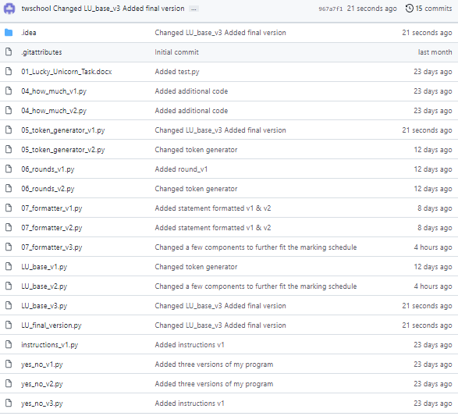
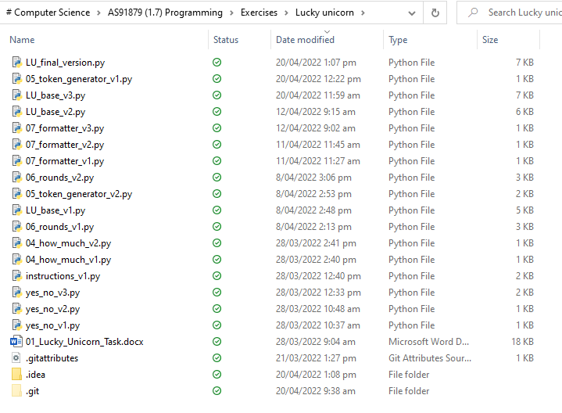
Version Control Evidence:
Your version control evidence should go here. This could be in the form of screenshots (both of your GitHub repository as well as your local project folder) as evidence of your incremental development.
<- (left): Local (OneDrive) directory
Project saved in GitHub repository (right) ->
Notes:
Your version control evidence should go here. This could be in the form of screenshots (both of your GitHub repository as well as your local project folder) as evidence of your incremental development.

Slide 37
Final Discussion:
While developing this program, I planned, tested and trialed its individual components and then later as a whole working game.
By decomposing the problem, I was able to plan my program efficiently and was able to focus on creating and testing small chunks of code.
Each of these chunks was thoroughly tested during and after construction.
By testing. I was able to find and fix the flaws in my program before combining them into the full program.
Having volunteers test my program enabled me to further improve it's functionality and get ideas about how to make it better which raised the reliability and quality of the finished program.
User feedback enabled me to look at the program from a non-programmer's point of view. This, combined with the information I got from the earlier planning, testing, and trialing, enabled me to produce a high-quality outcome. I tested my code using the built in pycharm pep8 checker and http://pep8online.com/ to make sure that it met the conventions regarding spacing and layout (see next slide).
Notes:
Discuss how the information from planning, testing and trialling of components assisted in the development of a high-quality outcome.

Slide 38
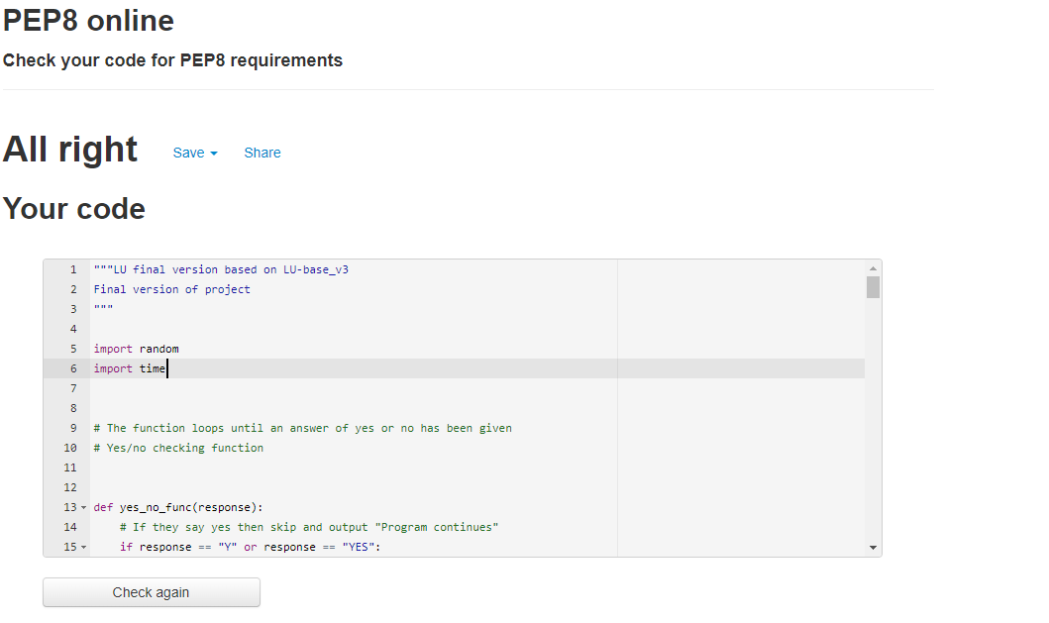
Evidence of meeting pep8 requirements

